Slide 1
Adaptive Audio Filtering on Dynamic Signals
Team 10: Ankur Sharma and Jonathan Somayajulu

Slide 2
Background/Motivation
Denoising and localizing sources in the presence of noise is a common problem in auditory processing
The human ear does this well. Computers? Not so much
Noise interruptions - major issue with audio streaming (Zoom, Skype, etc.)

Slide 3
Goals
To implement adaptive filtering techniques in an auditory focused, dynamic application in order to reduce or eliminate noise to a sufficient level
Demonstrate and test various filtering techniques to propose what the best solution could be
Propose and/or implement a hardware solution based on the best filter design

Slide 4
Methods
Audio samples from Noizeus website (6)
Algorithms processed audio samples at three different SNRs: 0 dB (baseline), 5 dB, and 10 dB
We used three different filter types: time, frequency, and collaborative functional link
Multiple speech sources were tested with various noise sources
We will focus on one speech and noise combination (Restaurant, Train, Exhibition Hall) at 0 dB and 10 dB SNR levels

Slide 5
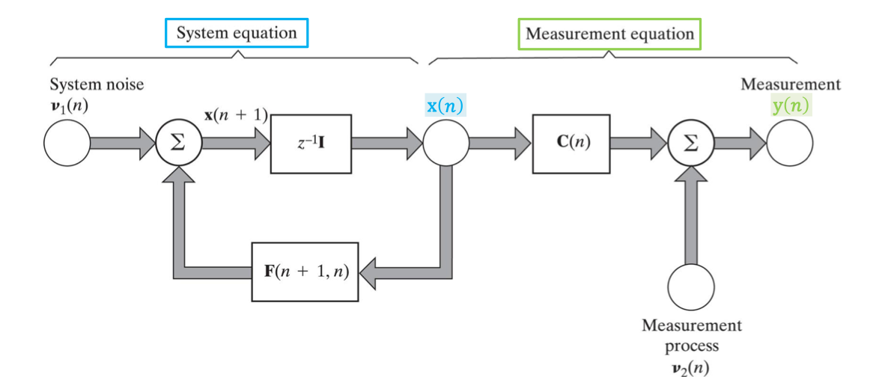
Background on Time Domain Filter: Kalman Filter
Comprised of Hidden State Variable (System) and Observed Variable (Measurement) Equations
Generalization of the RLS filter
Benefits:
Allows for filter adaptivity (improvement on Wiener Filter)
Shortcomings:
Must derive the state prediction correlation matrix through direct observation (must be known)
Figure 1: Kalman Filter Block Diagram (9)

Slide 6
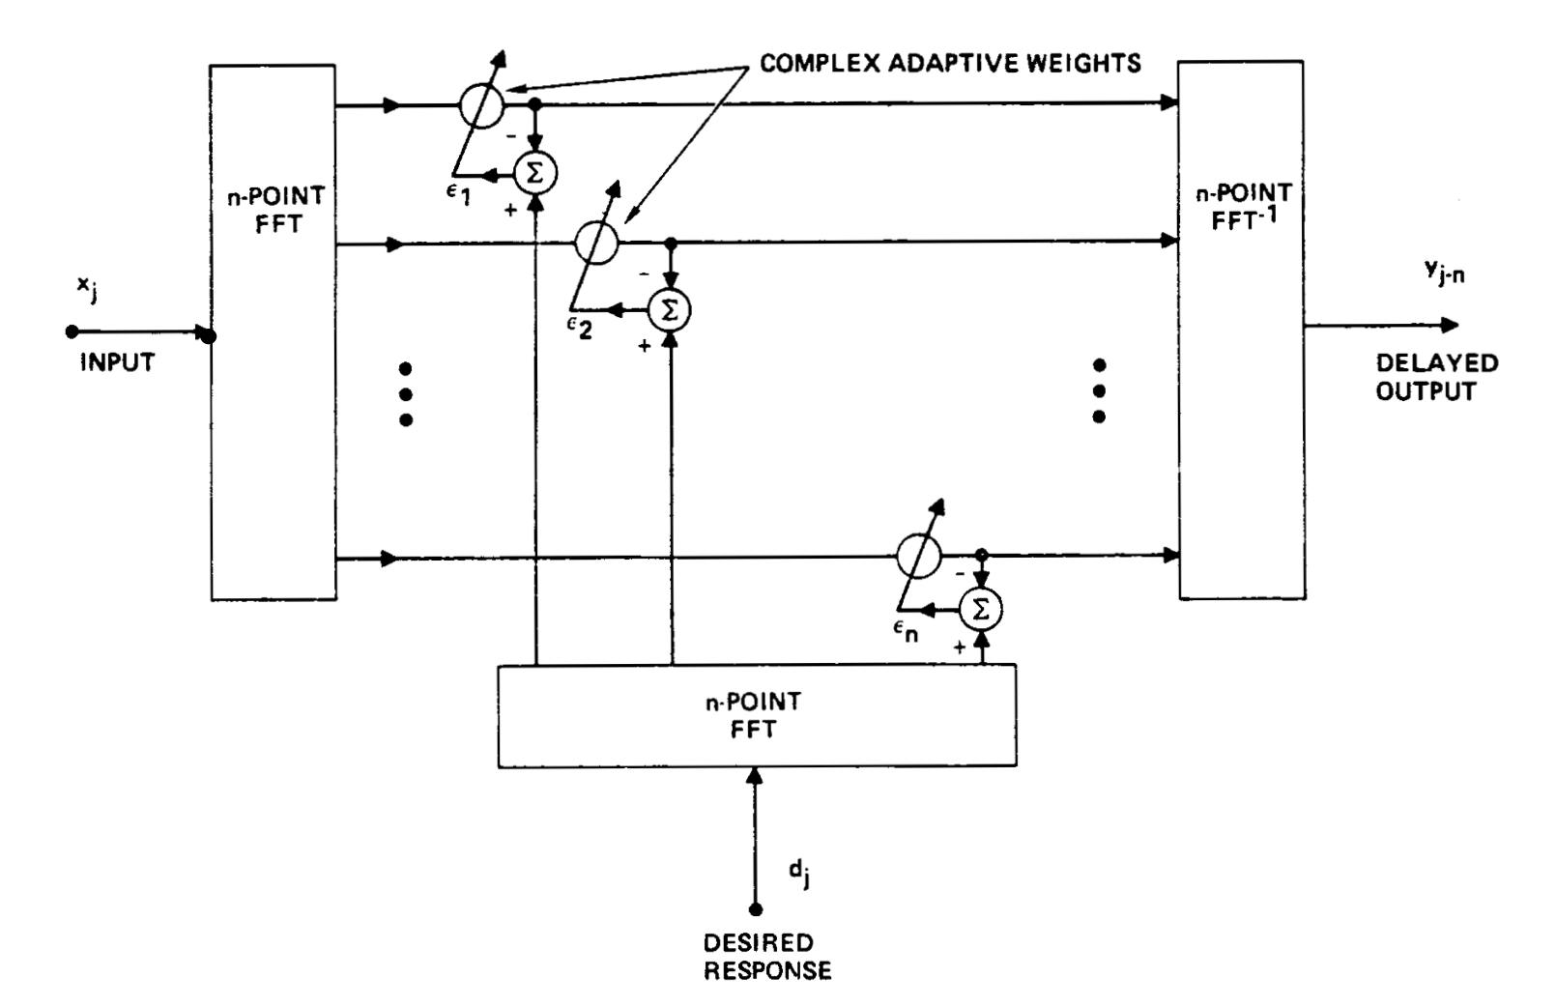
Background on Frequency Domain Filter: Frequency Domain Kalman Filter
Kalman Filter run in frequency domain
More useful for filtering audio components and frequency specific adaptive filtering
Has the same shortcomings of the time domain Kalman filter
Figure 2: Adaptive Filtering in Frequency Domain (8)

Slide 7
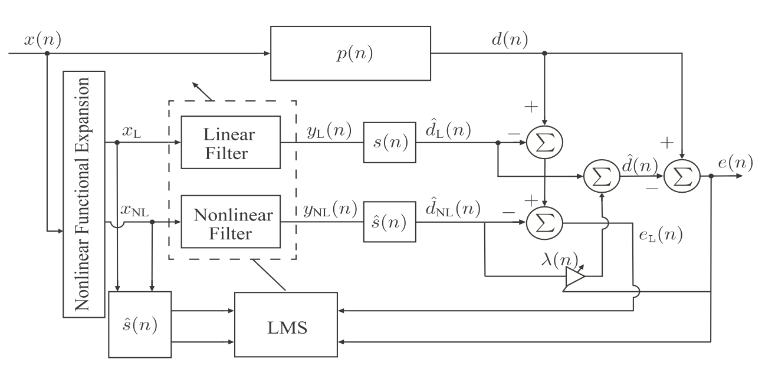
Background: Collaborative Functional Link Adaptive Filter
Filter architecture includes a linear filter and a non linear filter in “collaboration”
Noise error correction feedback loop is driven by LMS algorithm
d(n) driven by a combination of nonlinear and linear filtering
Benefits:
Adaptivity and error information is driven by correlation between nonlinear and linear filters and information exchange between the two filters
Figure 3: Block Diagram of Collaborative Function LInk Adaptive Filter (10)

Slide 8
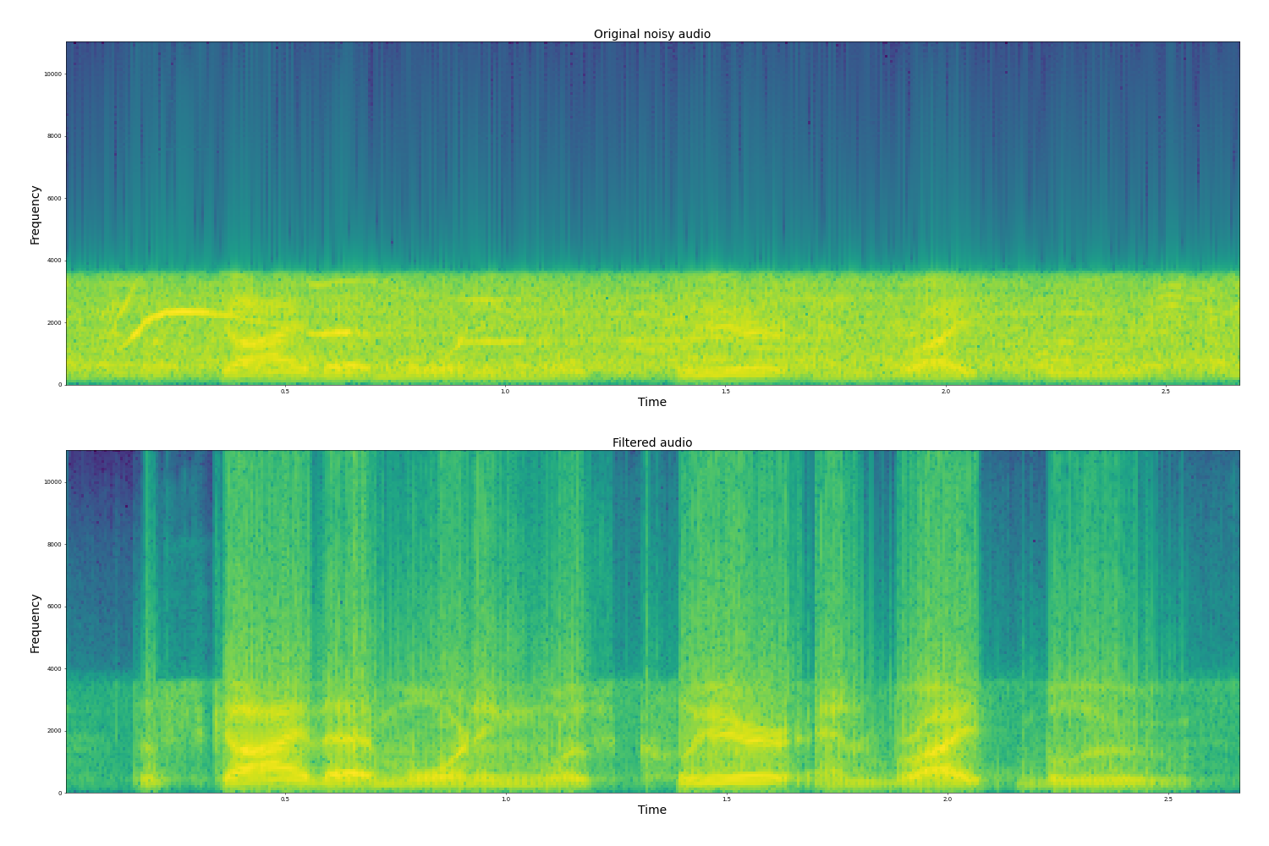
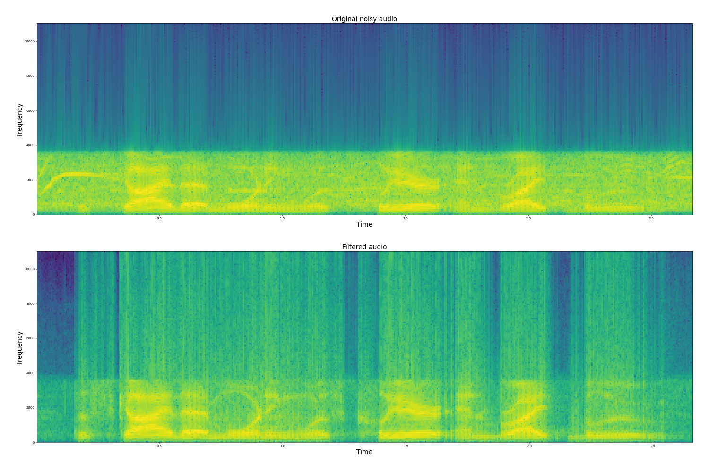

Results: Kalman Filter: Exhibition hall 0 dB and 10 dB

Slide 9
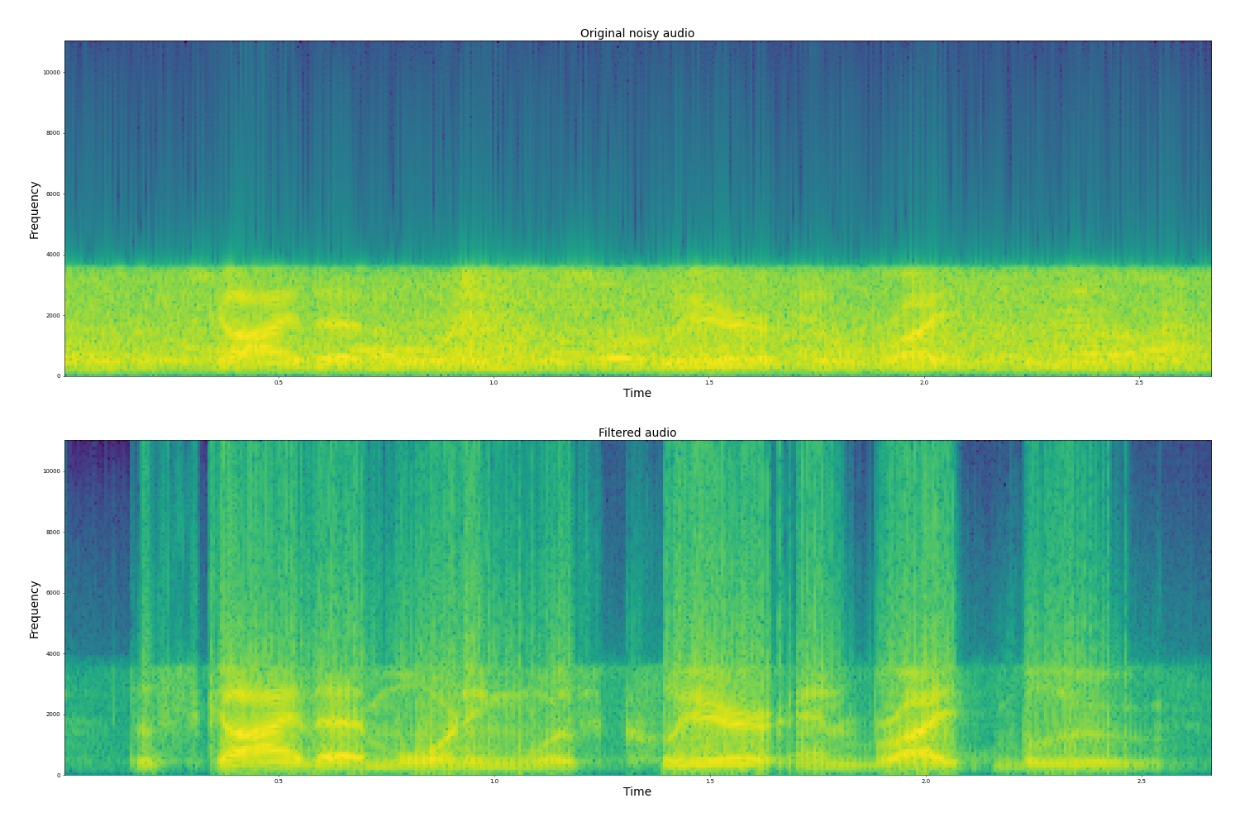
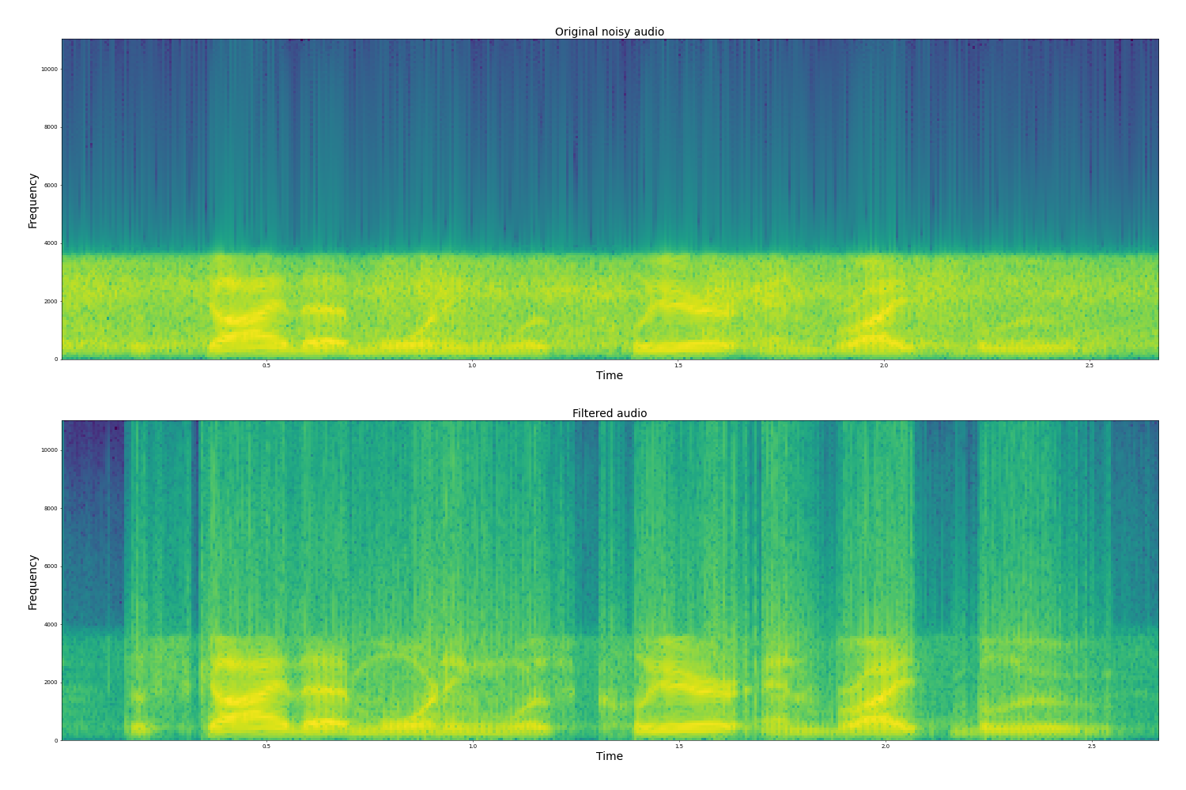
Results: Kalman Filter: Train (0 dB and 10 dB)

Slide 10
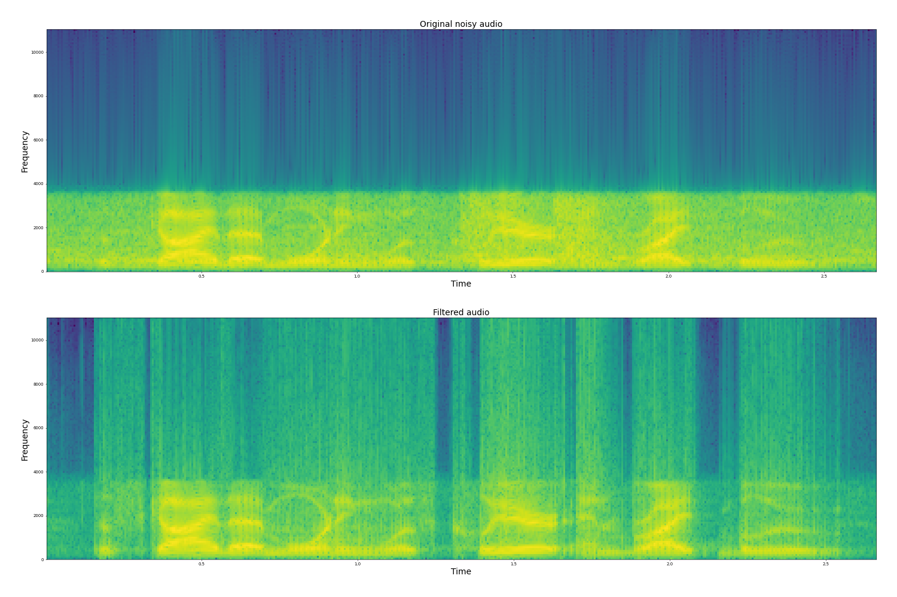
Results: Kalman Filter: Restaurant (0 dB and 10 dB)

Slide 11
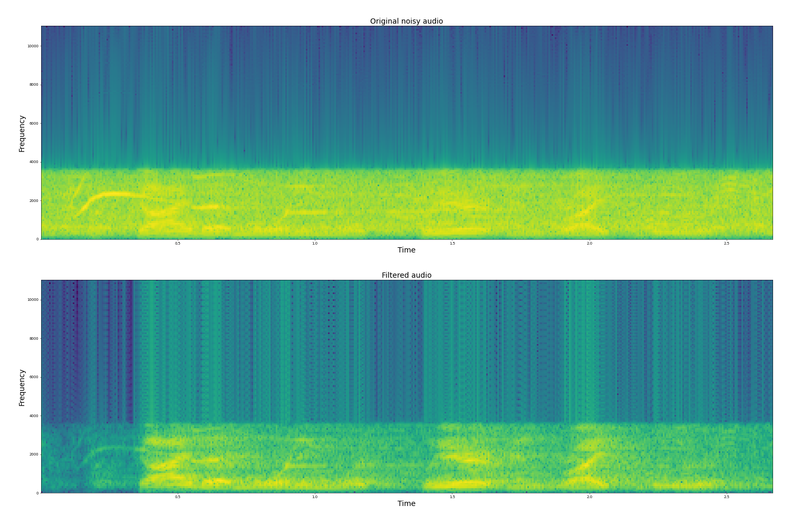
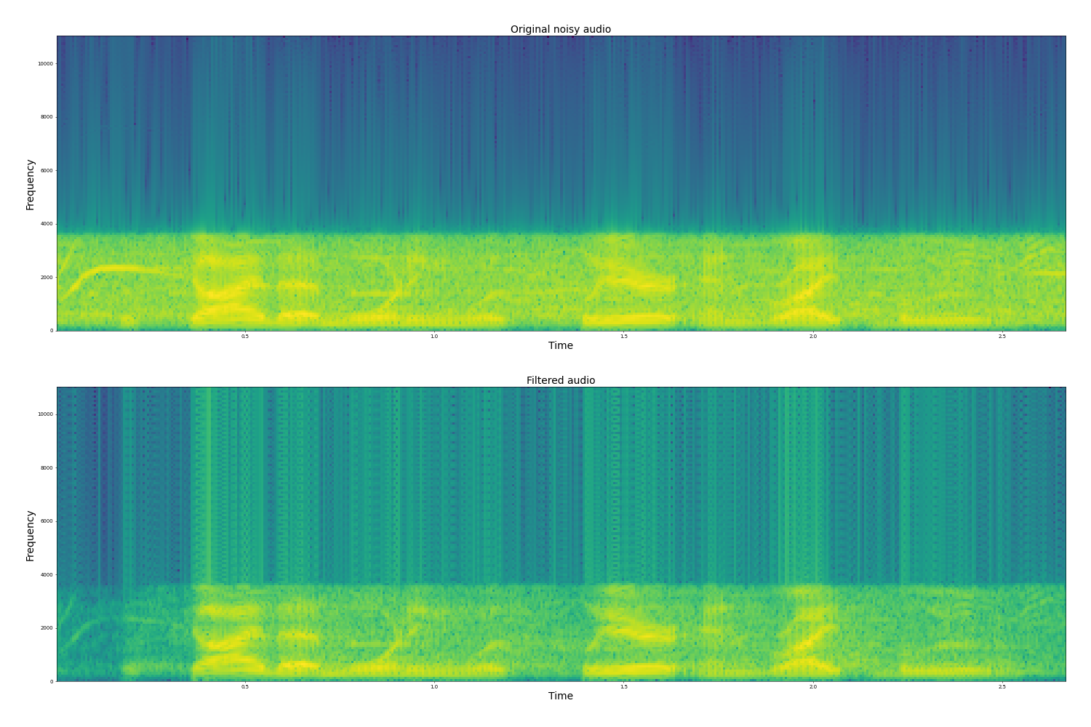
Results: Frequency Domain Kalman Filter: Exhibition: 0 dB and 10 dB)

Slide 12
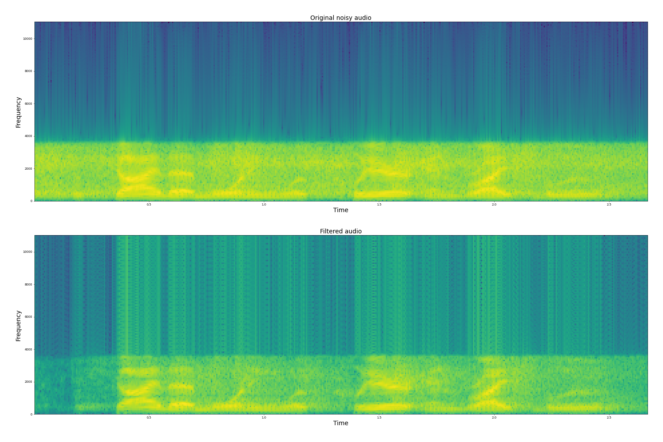
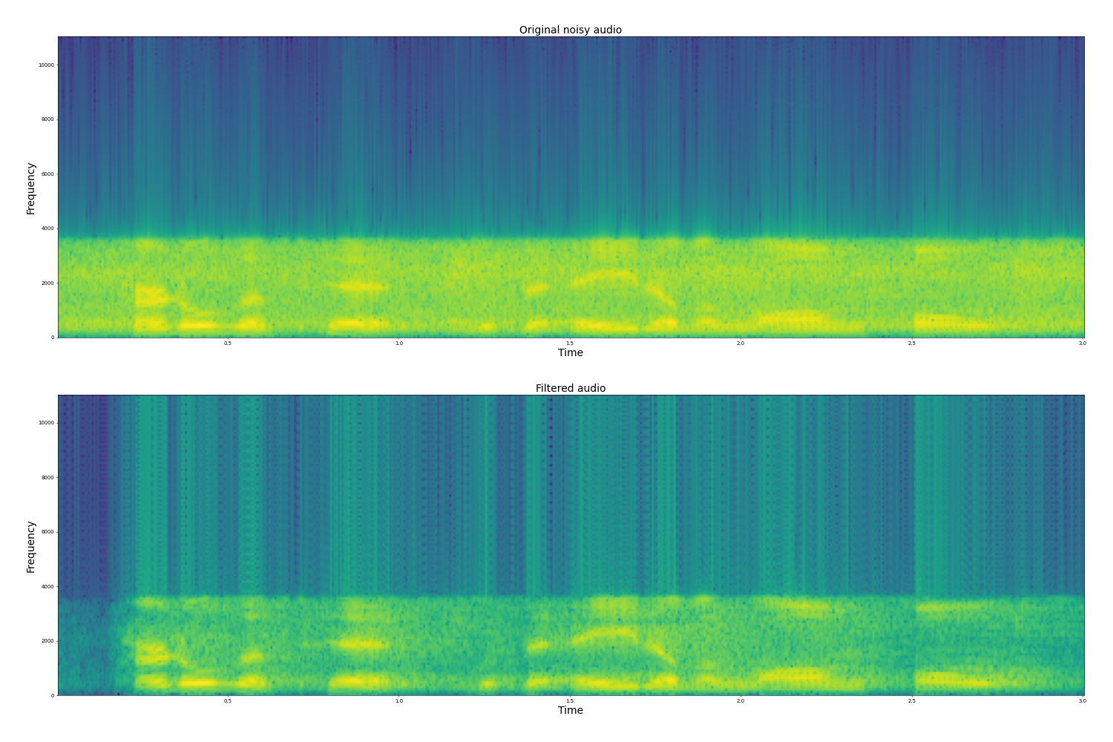
Results: Frequency Domain Kalman Filter: Train: 0 dB and 10 dB)

Slide 13
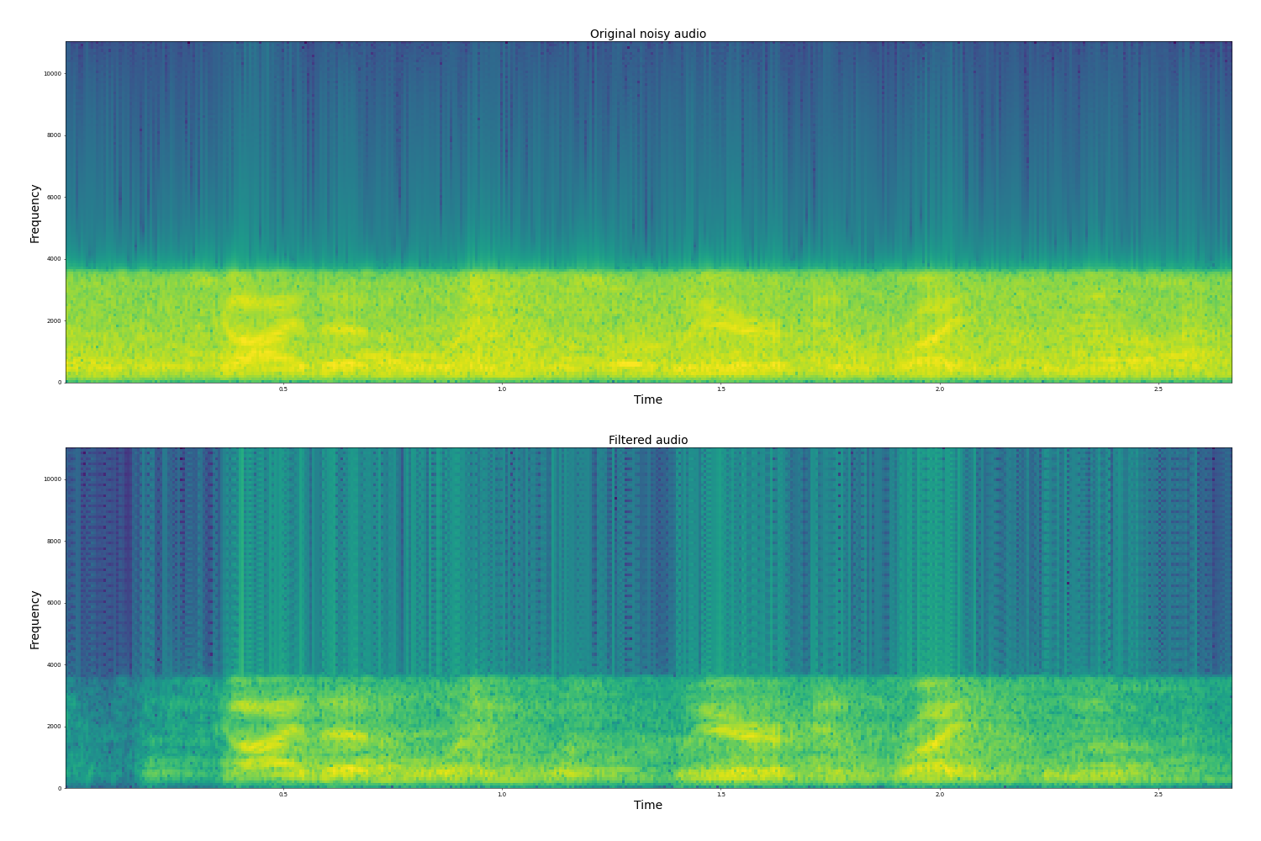
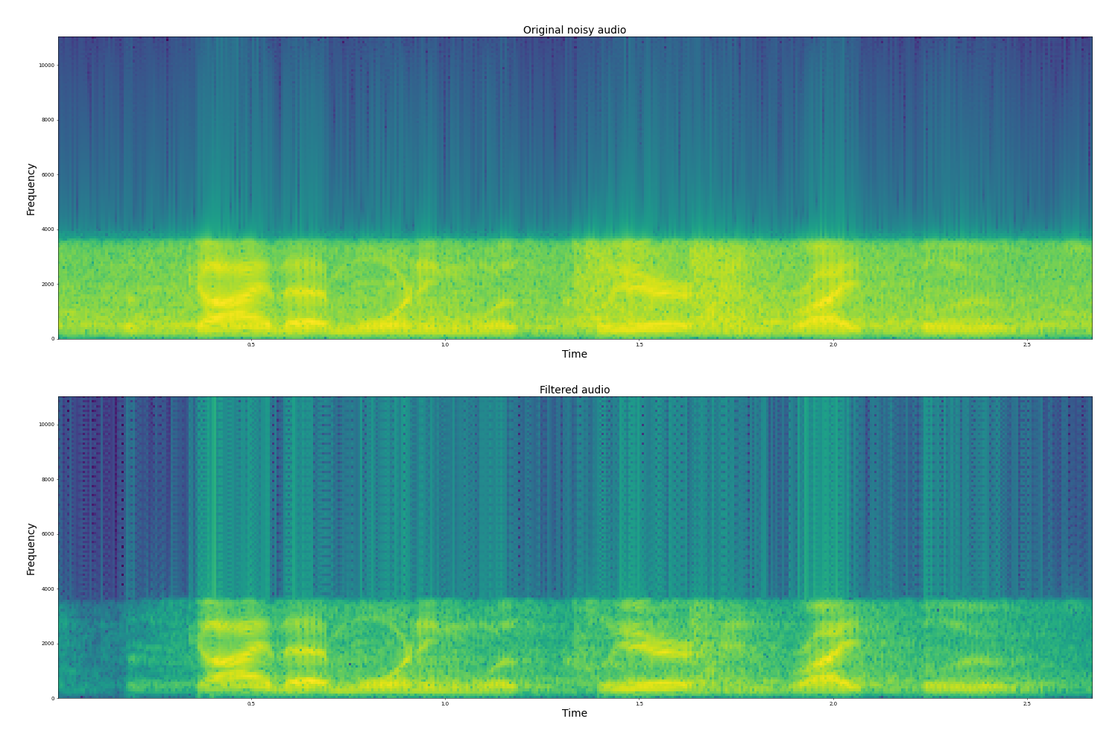
Results: Frequency Domain Kalman Filter: Restaurant: 0 dB and 10 dB)

Slide 14
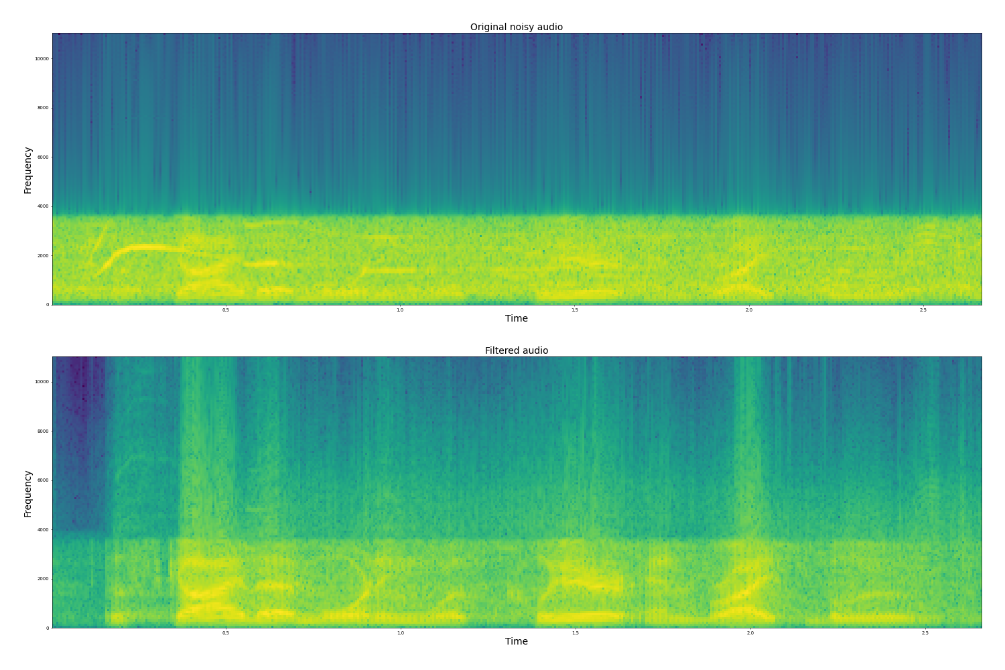
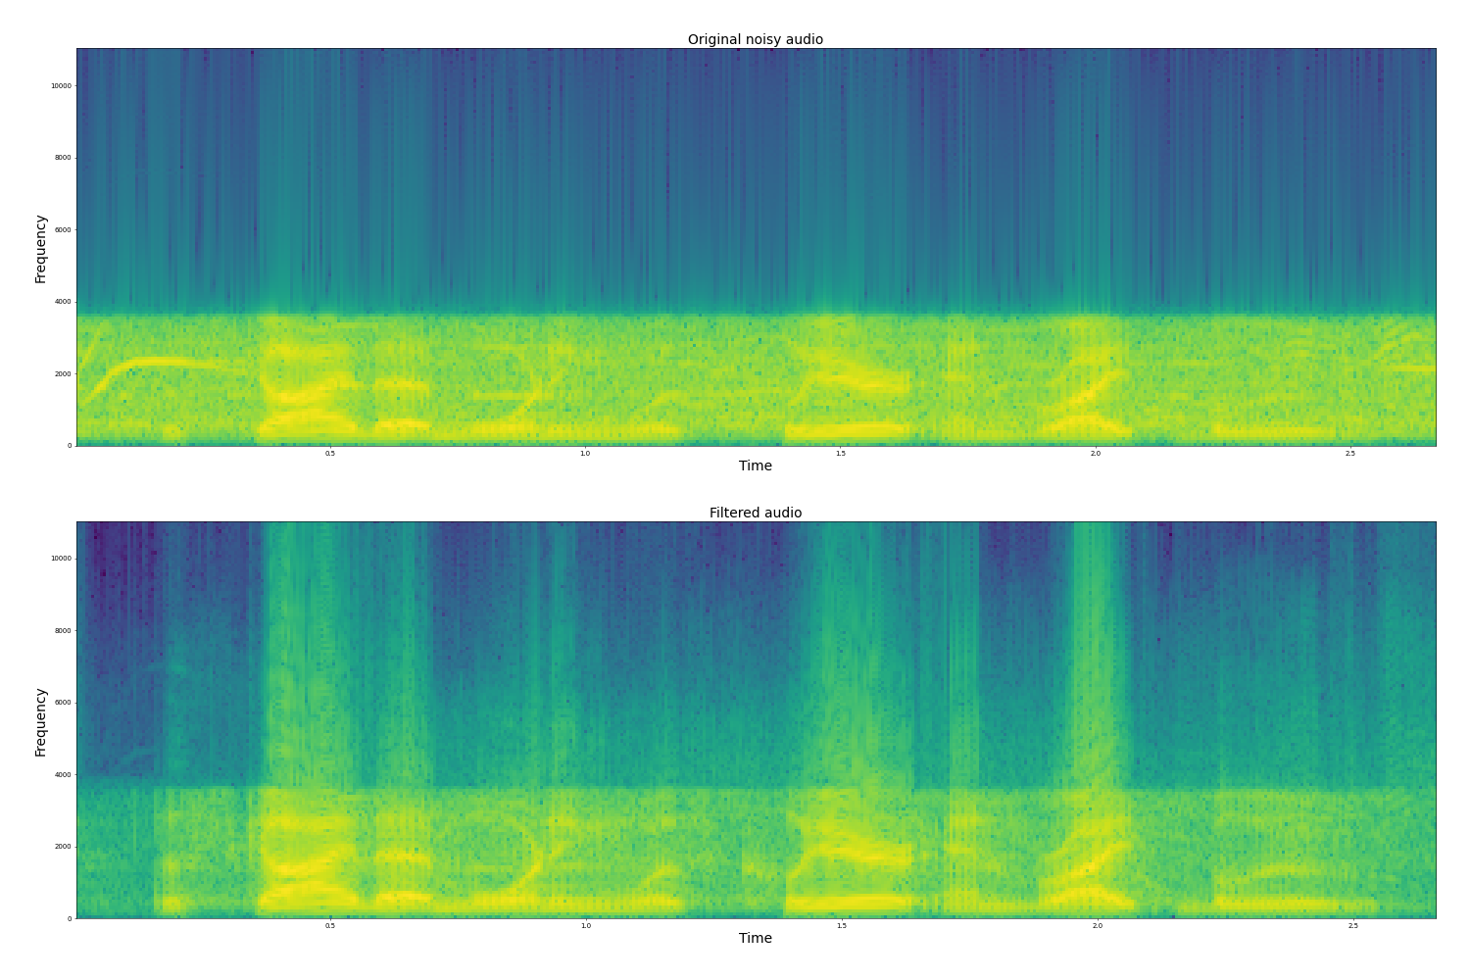
Results: Collaborative Functional Link Filter: Exhibition: 0 dB and 10 dB)

Slide 15
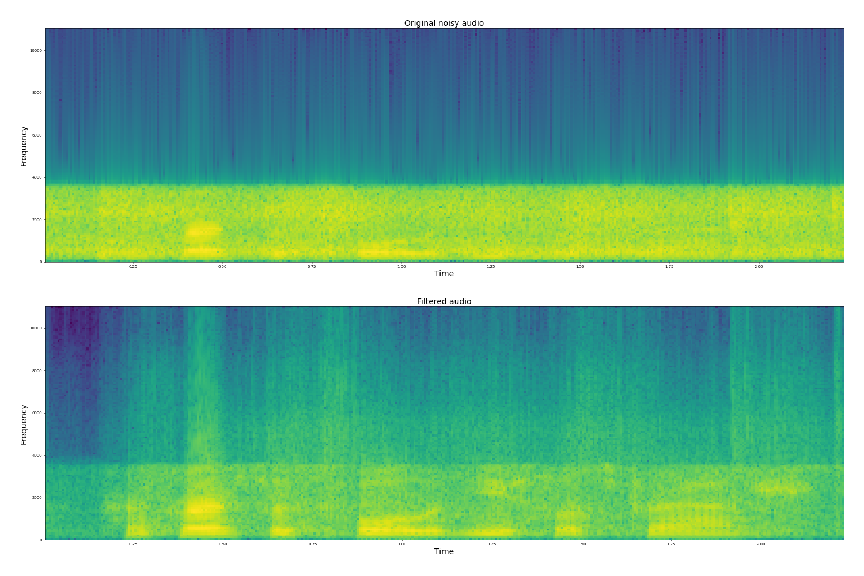
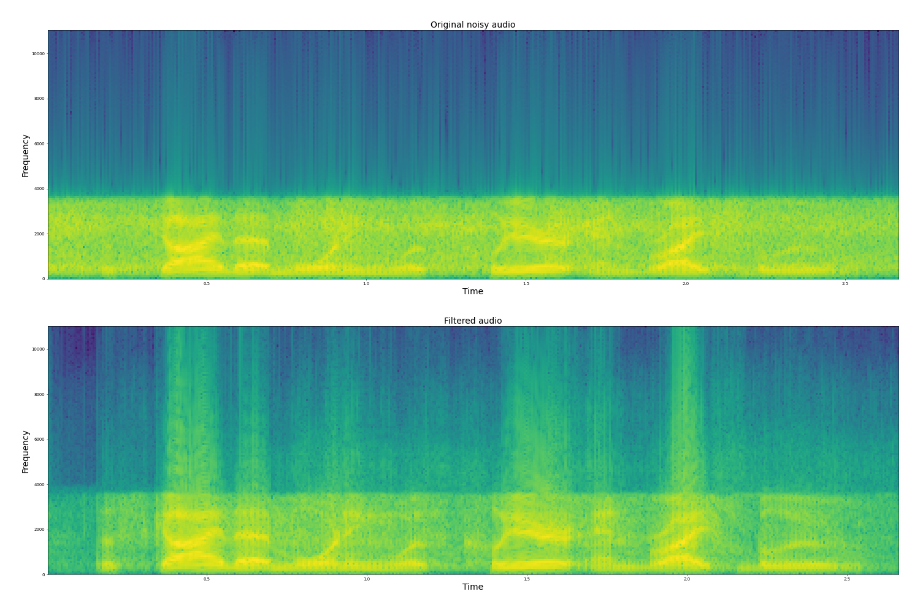
Results: Collaborative Functional Link Filter: Train: 0 dB and 10 dB)

Slide 16
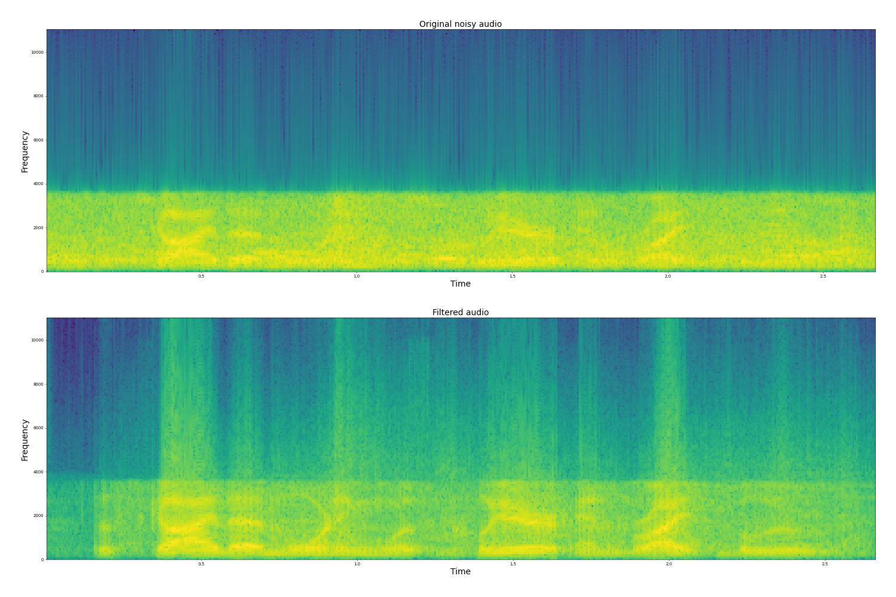
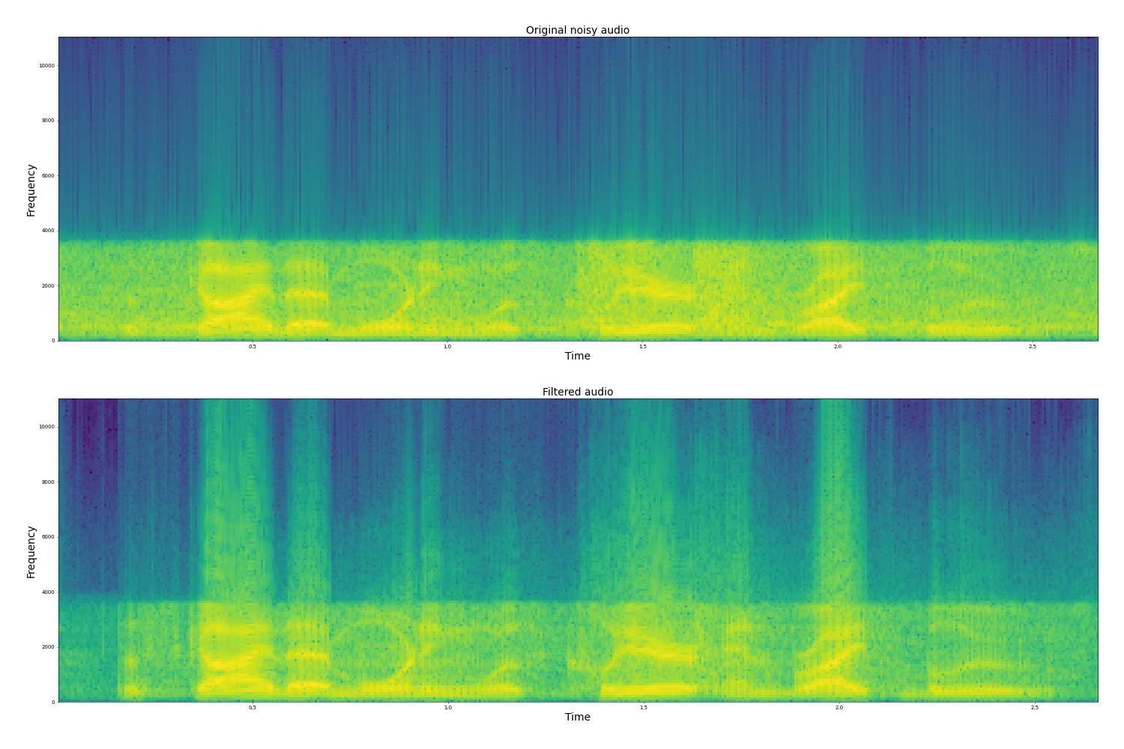
Results: Collaborative Functional Link Filter: Restaurant: 0 dB and 10 dB)

Slide 17
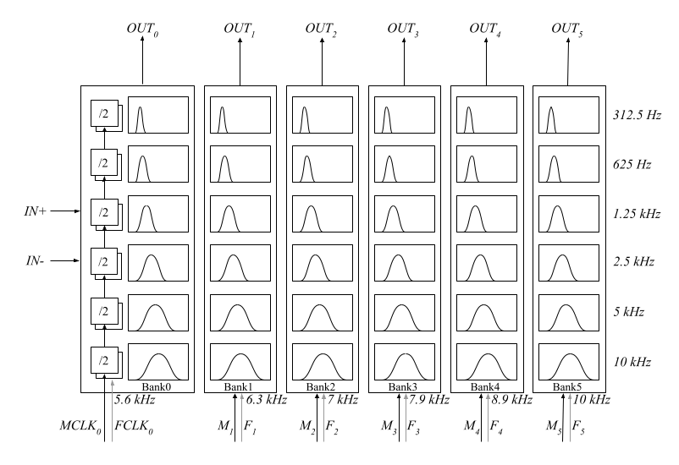
Do these filters work in low power hardware?
In FPGA… maybe, but in IC - No!
In cochlea design: there is a comparator which is very noise sensitive.
This comparator is also a source of noise itself.
The noise distribution can never be known before fabrication
Hence, we need an adaptive filter to compensate for the error in each comparator.

Slide 18
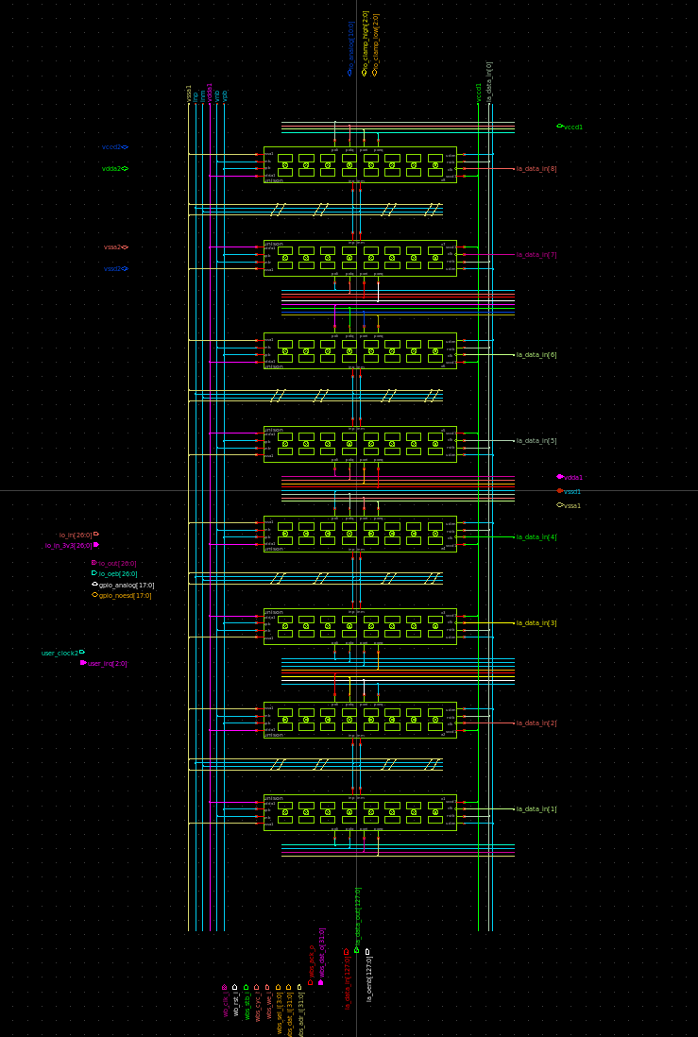
Top Level Diagram of the chip

Slide 19
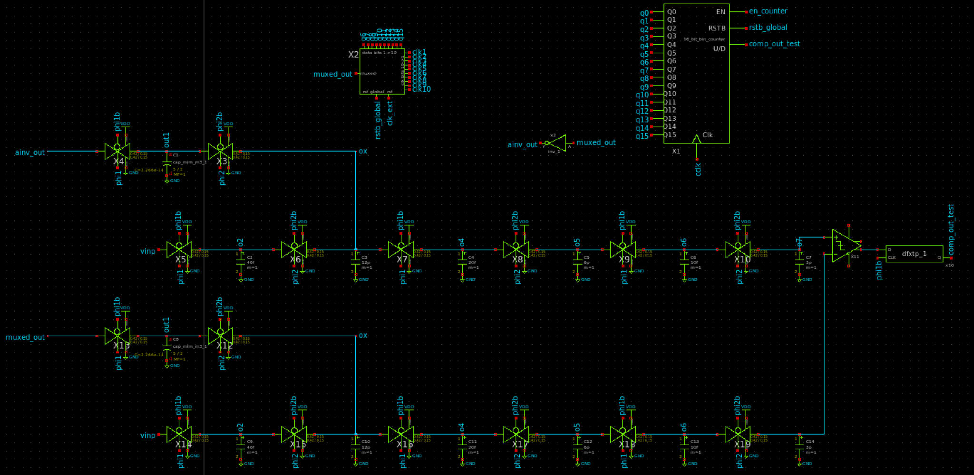
A low power hardware adaptation strategy
Fig 4. The block diagram of adaptive feedback

Slide 20
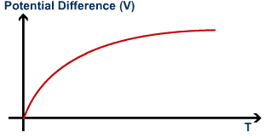
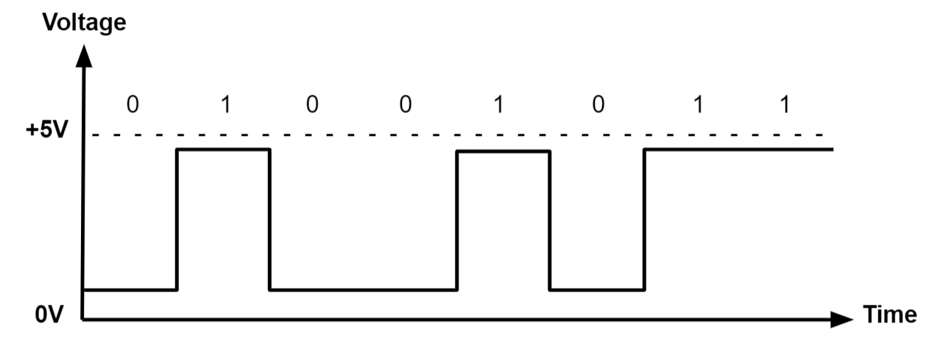
How does the adaptive compensation work?
Comparator is a sensitive piece of hardware that determines whether one signal is higher than the other.
If comparator is leaning more towards one signal, we count these increments.
Depending on the count, we select the 10 most significant bits in gray fashion
This is sent back through the filter as a compensation on top of the biggest capacitor in the circuit.
When the digital bits are passed through the low pass filter, we are only left with the DC component of the feedback which changes the common mode of the signal.
Fig 5. Digital to analog conversion (Monolithic power systems)

Slide 21
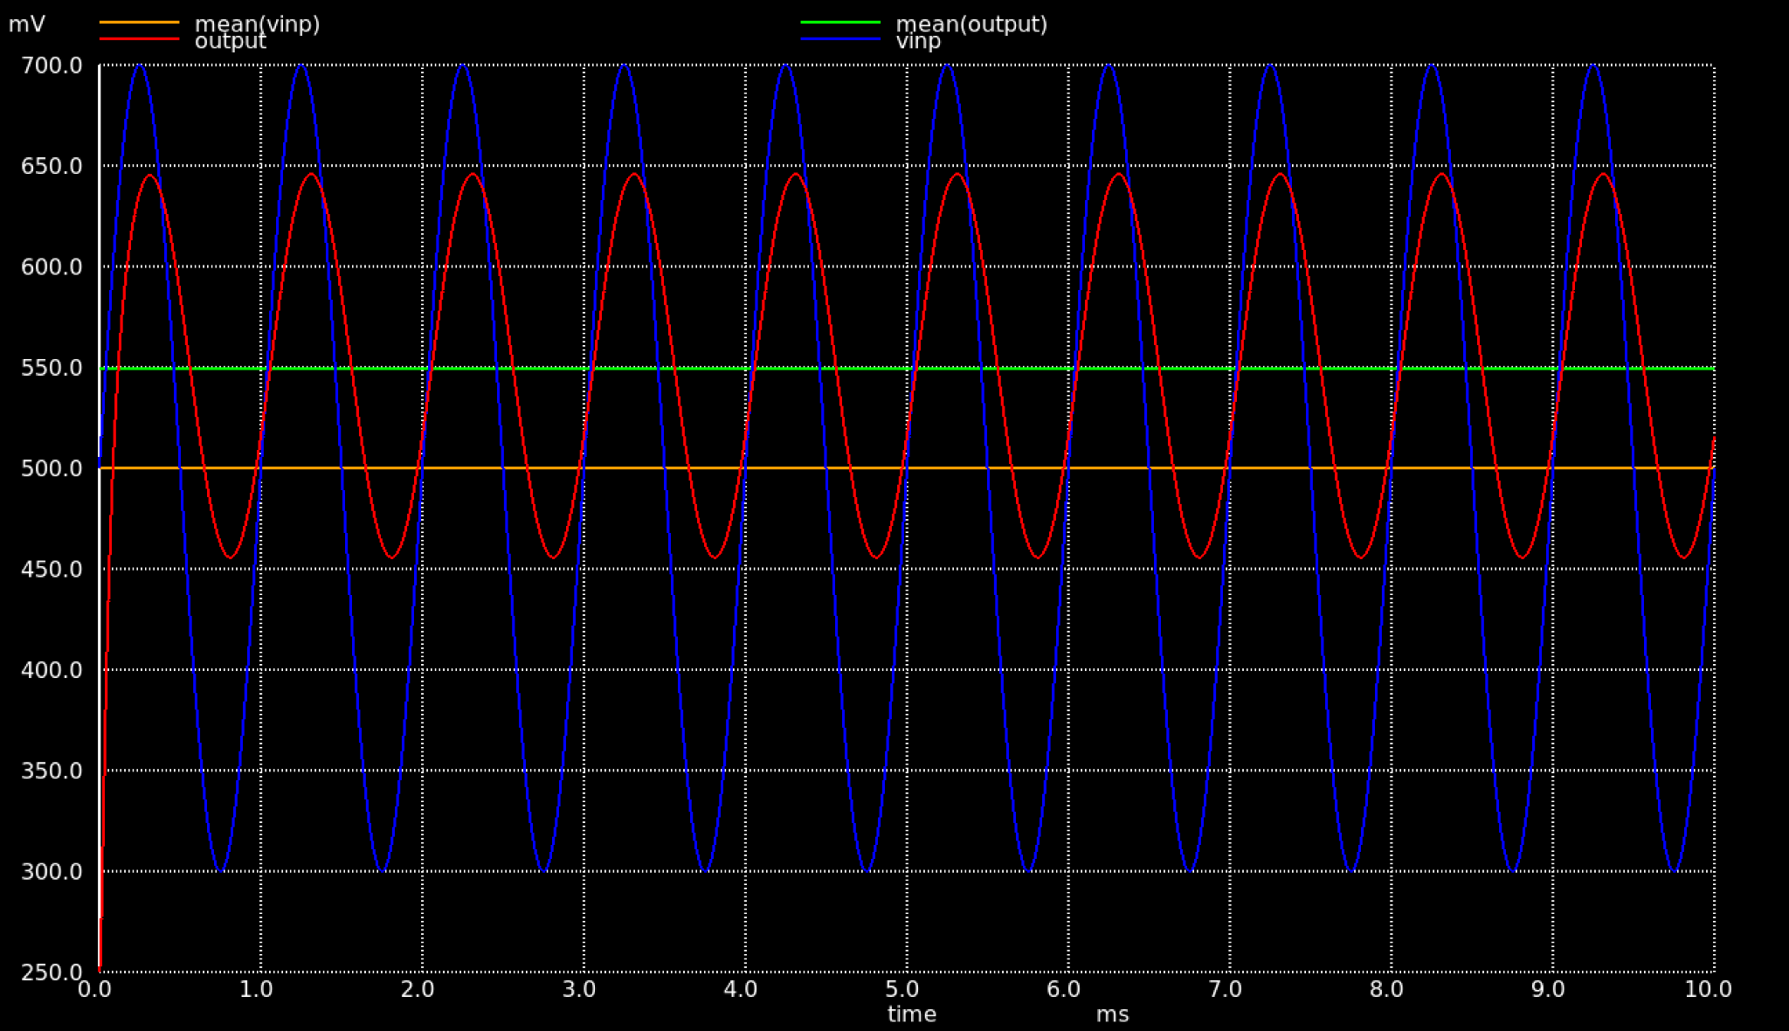
Output of the compensated filter
Initial common mode of the signal: 500mV
Compensated common mode of the signal: 550mV
This change is extremely important for the sensitivity of our comparator.

Slide 22
More to add in the final report:
Simulink models for various filters
Details of more adaptive filters tested and their results

Slide 23
References
Edwards, Robert Timothy. Time-frequency acoustic processing and recognition: Analysis and analog VLSI implementations. The Johns Hopkins University, 1999.
https://github.com/ewan-xu/pyaec
Sarpeshkar, R. (2010). Ultra Low Power Bioelectronics: Fundamentals, Biomedical Applications, and Bio-Inspired Systems. Cambridge: Cambridge University Press. doi:10.1017/CBO9780511841446
J.M. Kates. Accurate tuning curves in a cochlear model. IEEE Transactions on Speech and Audio Processing, 1(4):453–462, 1993. doi: 10.1109/89.242491.
Alfredo Rosado-Mu˜noz, Manuel Bataller-Mompe´an, Emilio Soria-Olivas, Claudio Scarante, and Juan F Guerrero-Mart´ınez. Fpga implementation of an adaptive filter robust to impulsive noise: Two approaches. IEEE Transactions on Industrial Electronics, 58(3):860–870, 2009.
https://ecs.utdallas.edu/loizou/speech/noizeus/
Hu, Y. and Loizou, P. (2007). “Subjective evaluation and comparison of speech enhancement algorithms,” Speech Communication, 49, 588-601.
M. Dentino, J. McCool and B. Widrow, "Adaptive filtering in the frequency domain," in Proceedings of the IEEE, vol. 66, no. 12, pp. 1658-1659, Dec. 1978, doi: 10.1109/PROC.1978.11177.
Vasconuelos, M. (2022). Kalman Filter [PowerPoint Slides].
Zhao, S., Zhang, L., & Lu, W. (2021). A generalized collaborative functional link adaptive filter for Nonlinear Active Noise Control. Applied Acoustics, 175, 107799. https://doi.org/10.1016/j.apacoust.2020.107799
https://drive.google.com/drive/u/3/folders/1CNKlnhV81SYNPVJQHtsb5NWO_7mVxgnF

Slide 24
Thanks!

